Slide 1
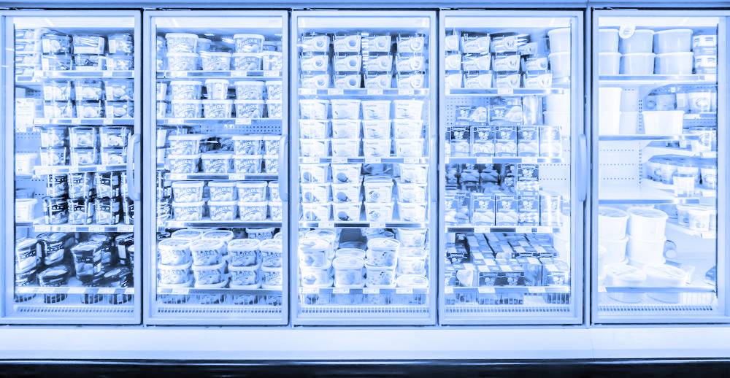
2021 ESDC HACKATHON
TEAM ICE CREAM!!
So creamy

Slide 2
System Overview
Online Web Pages
User Query:
Company Name or Company Address
company_data.csv
suspected_fraud_data.csv
Stored Company data
User Interface
Populate database script
Web scraping script
populate_data.py
extract_data.py
Notes:
Federal Business Number registry from corporations Canada

Slide 3
Data Scraping
Three main data sources used
Two for company information
One for red flag detection
All data sources extracted follow the websites’ terms and conditions
Some sites that we would have liked to use otherwise specifically state in their terms of use that web scraping is not permitted, such as https://beta.canadasbusinessregistries.ca
Variety of scraping methods used to extract data including Selenium, BeautifulSoup, GET Requests
Data formats parsed included JSON and XML
Missing data is displayed as “Unknown” in the application
Notes:
We should emphasize that we did not break any rules in our data extraction, most other teams will probably not think of this.

Slide 4
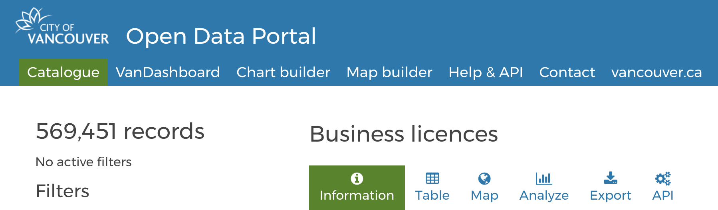
Data Source 1: City of Vancouver Open Data Portal
Used for populating business data fields
The sourced data is updated regularly, previous folder years are expected to remain static
Accessed via public API

Slide 5
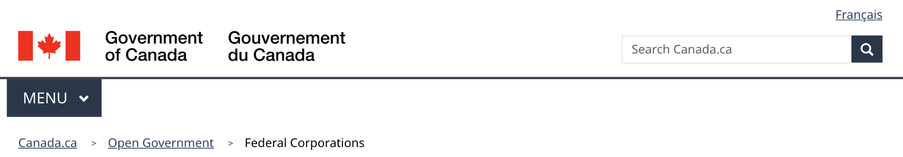
Data Source 2: Federal BN Registry
Used for populating business data fields
The data is updated weekly according to comments on the site
One script automatically downloads the data in bulk as XML files
Another script scraps the director names based on extracted company names and IDs using Selenium

Slide 6
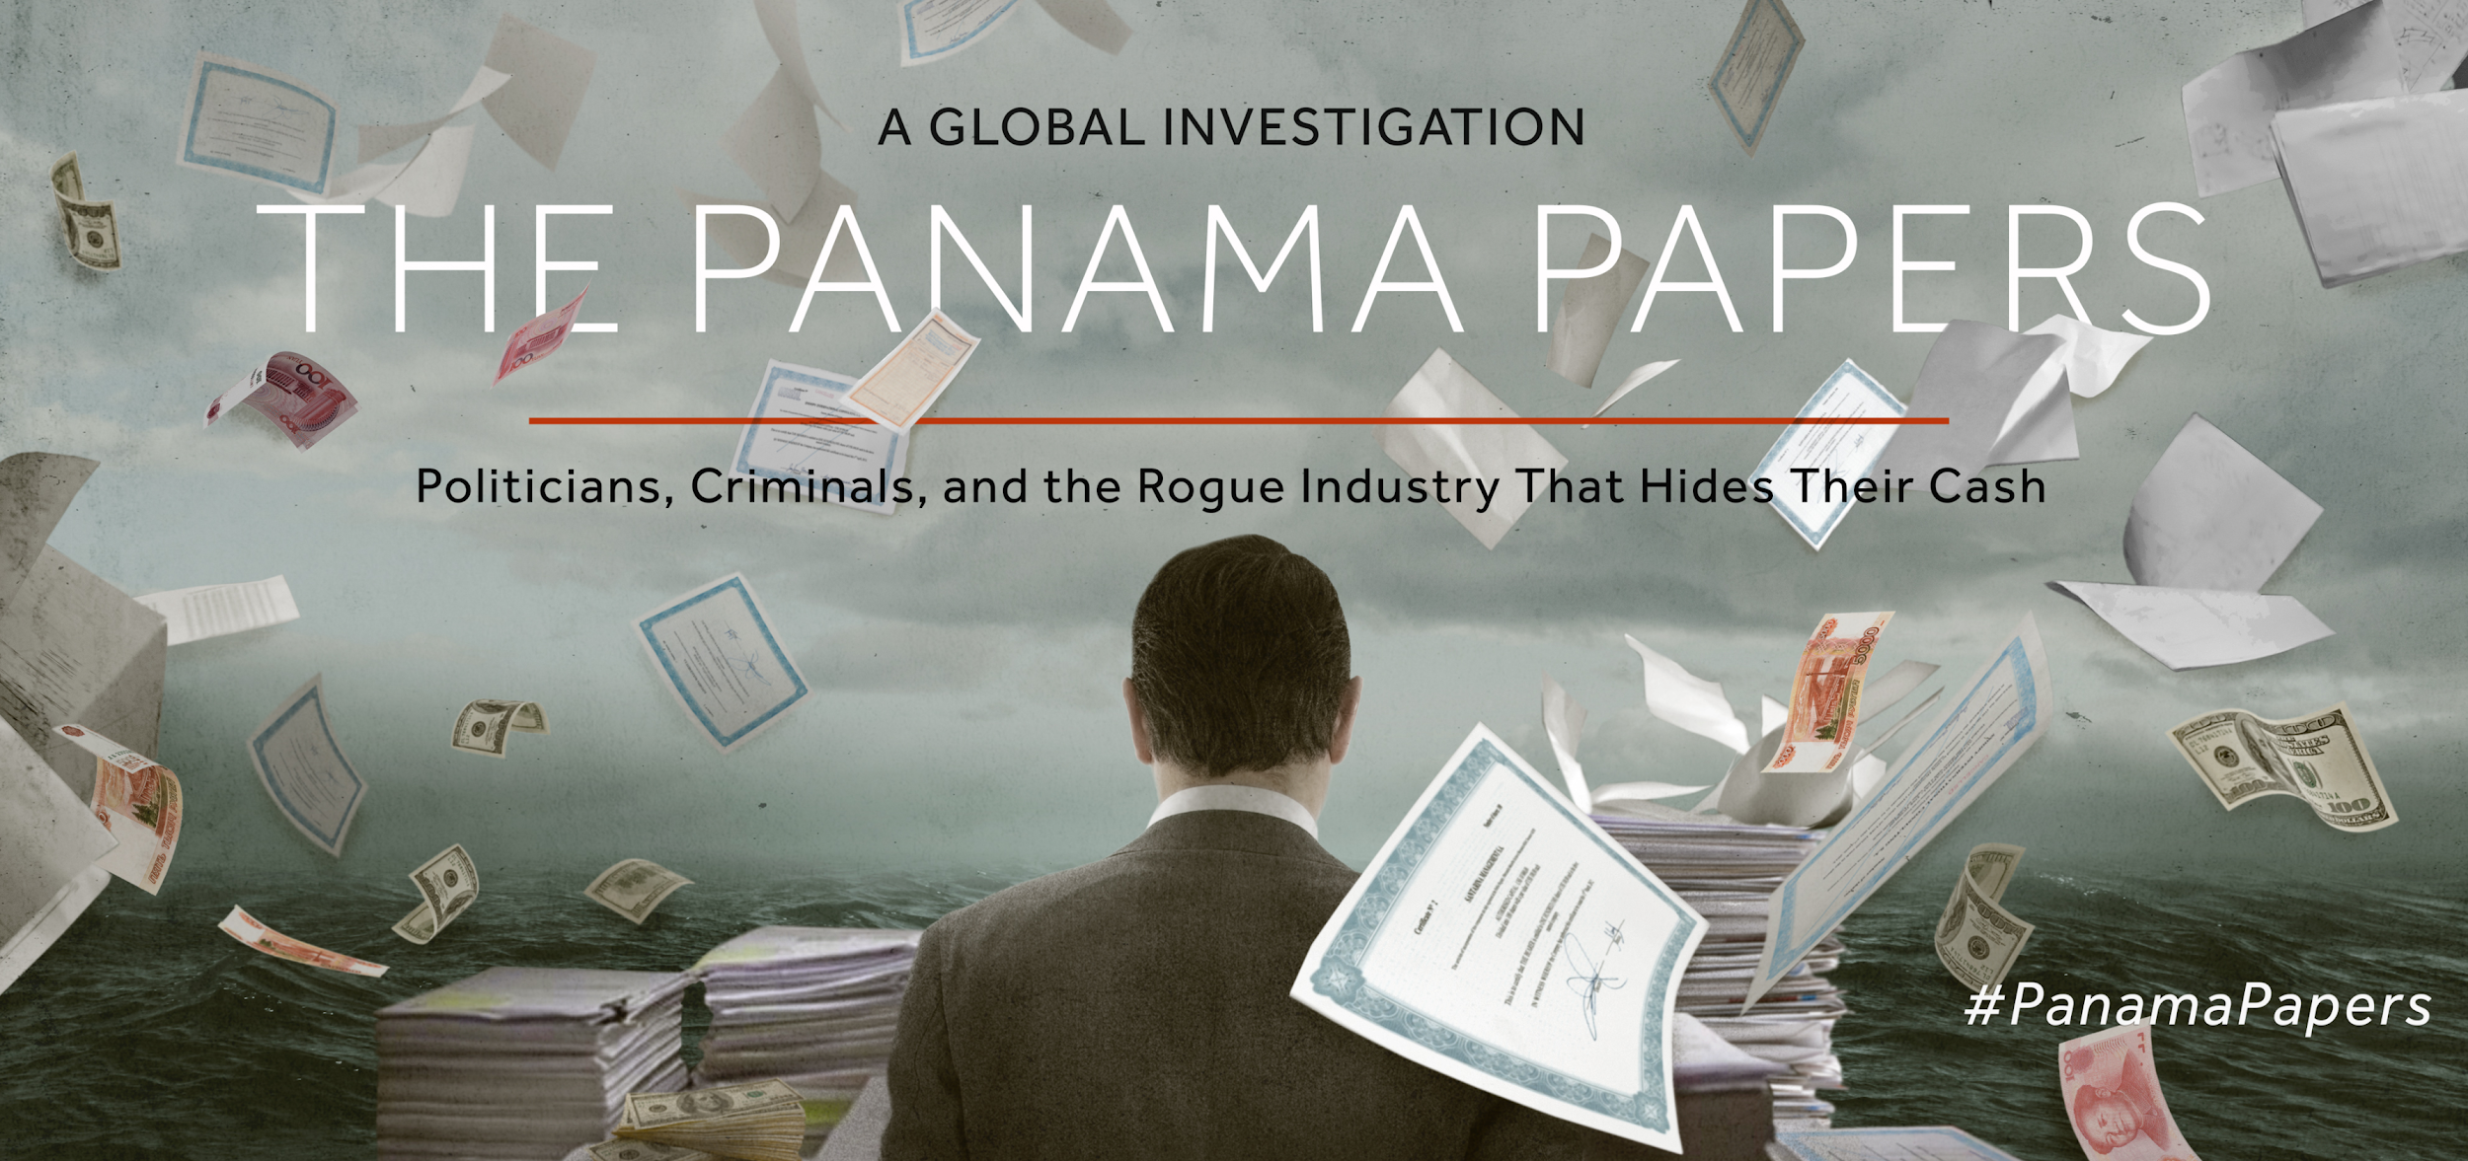
Data Source 3: Offshore leaks database
Used for legal check and offshore accounts for potential fraud detection
Multiple sub-sources scraped, including:
Offshore leaks
Bahamas Leaks
Panama Papers
CanLII Federal
CanLII Provincial (BC)

Slide 7
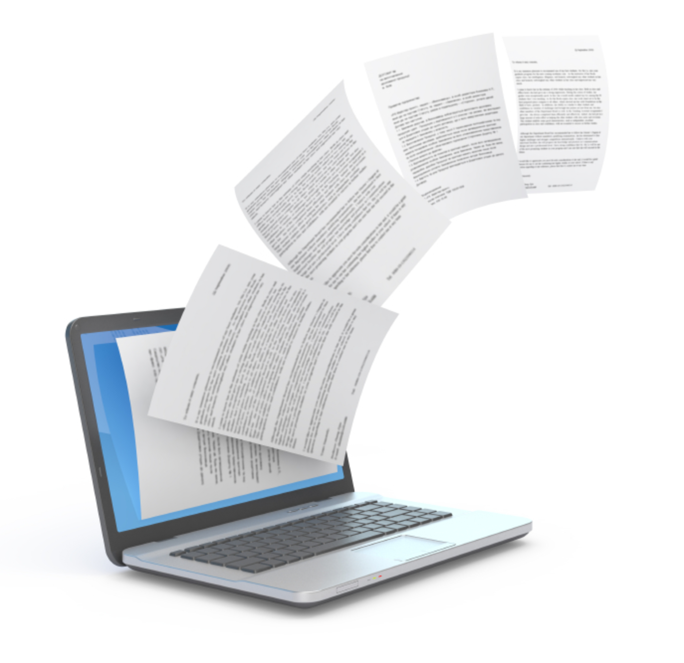
Extracted Data and Storage
Data details
Over 1,000,000 rows of company details exported
~790,000 unique corporation IDs
New fields include
Business numbers
Addresses for federally registered companies
Aliases
Directors
Storage system
Currently using a series of csv files
Future plan is to migrate to database

Slide 8

Data analysis
Fraud detection algorithms:
Word similarity comparisons (Levenshtein distance)
Business number validation
Fraud detection reasoning:
Legal history with regards to bad faith
Multiple addresses for the same building
Lack of electronic paper trail
Mismatched addresses
Notes:
bad faith
1) n. intentional dishonest act by not fulfilling legal or contractual obligations, misleading another, entering into an agreement without the intention or means to fulfill it, or violating basic standards of honesty in dealing with others. Most states recognize what is called "implied covenant of good faith and fair dealing" which is breached by acts of bad faith, for which a lawsuit may be brought (filed) for the breach (just as one might sue for breach of contract). The question of bad faith may be raised as a defense to a suit on a contract. 2) adj. when there is bad faith then a transaction is called a "bad faith" contract or "bad faith" offer.
Regarding Electronic Paper Trail: Defined as lack of presence on leading search engine and social networks

Slide 9
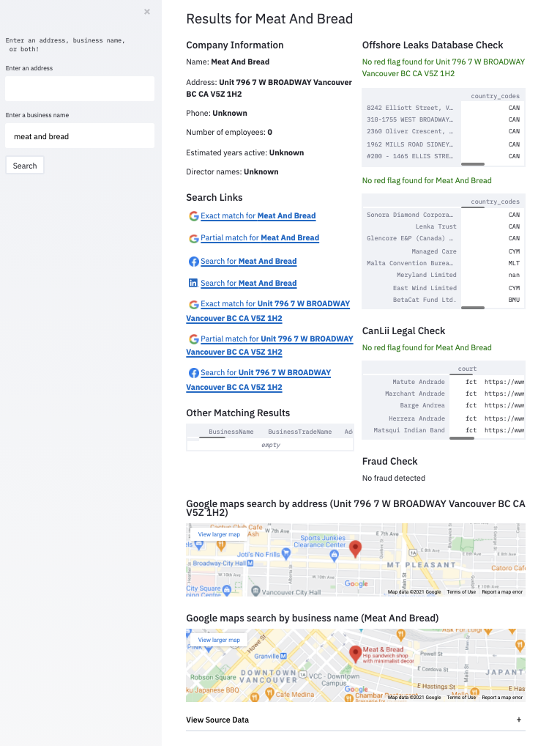
User Interface
UI is built with Streamlit
Designed with the end user in mind
Able to search with either
Company address
Company name
Company name AND address
Easy to quickly read summary
Side-by-side maps for comparison
Displays key information
Includes helpful links for manual review
Helpful error messages
Fraud/Legal checks with suspicion score
Notes:
Designed for end user points are for EMPATHY judging criteria

Slide 10
Usage Instructions
Install by following instructions on https://github.com/sbabicki/ice-cream
Enter in business name, address, or both
If there are multiple matches for the same address these matches will also be shown along with key characteristics
Matches for related companies and individuals (the latter yet to be implemented) that have a higher likelihood of bad faith actions
Notes:
Investigator can search suspicious matches to follow up

Slide 11

Ethical Implications
Bias concerns, the following minorities may be targeted disproportionately:
Immigrants - may not be familiar with Canadian regulations
Technologically illiterate - lower online presence
Lack of resources - not enough resources to pay to advertise or set up online presence
Type of business - certain types businesses will have less of an online presence
Legal records - relying heavily on past behaviour to predict future behaviour
Potential ethical concerns for our product:
Providing legal records
May not otherwise be checked
Maps displayed for all companies
May lead to subconscious biases
Notes:
(EMPATHY SECTION)

Slide 12
Future plans
Additional Feature Aspirations
Move data sources to database
Additional data sources
Partial string matching for address and business name lookup
Fuzzy matching improvement for Offshore Leaks DB
Search by director name
Automated fraud detection score based on company characteristics
Link for viewing matching data result
API integration with app
We are confident that with slightly more time we could implement many of these features!

Slide 13
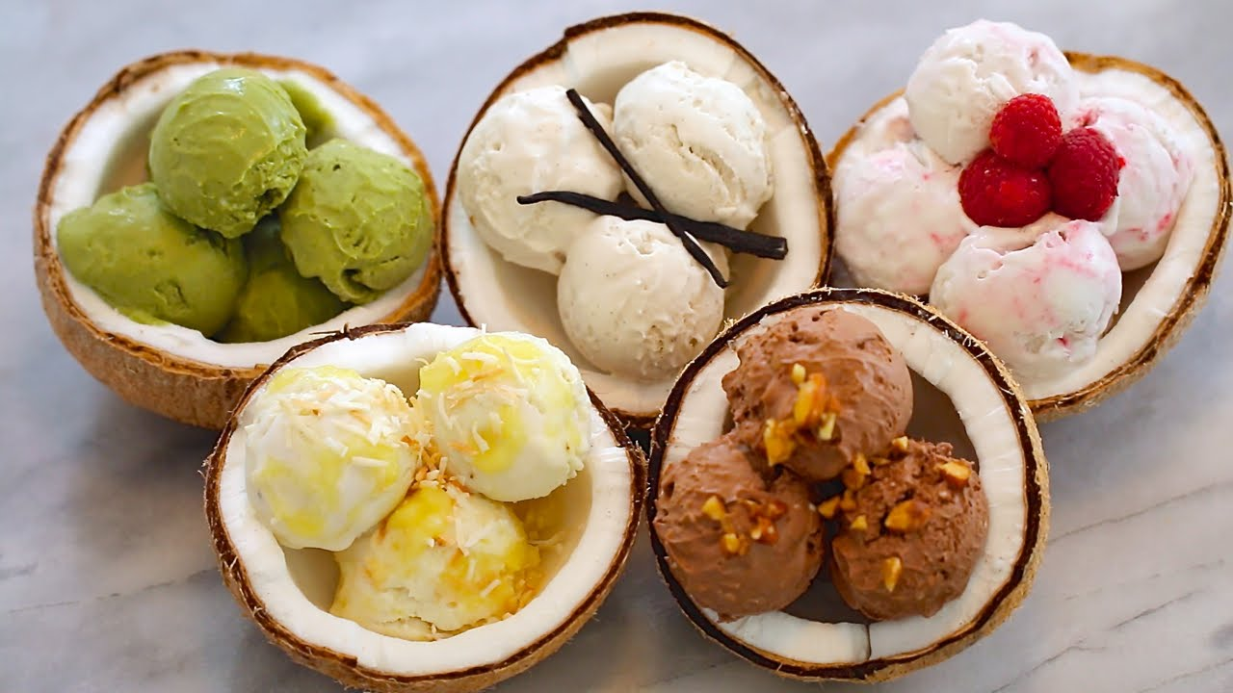
Questions for us?
Junghoo
Elanor
Sasha
William
Aidan

